Slide 1
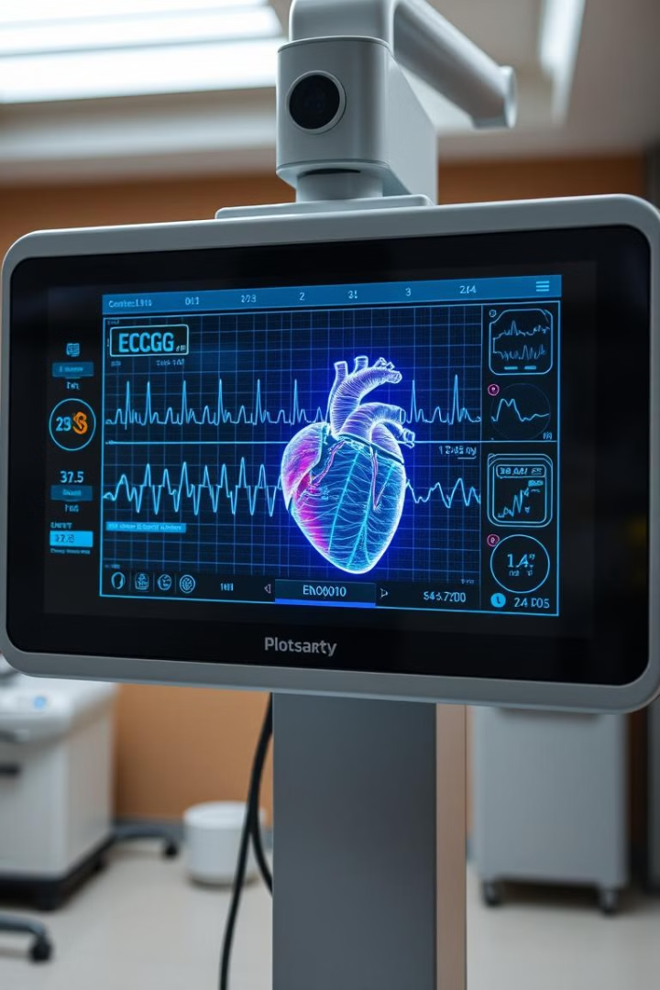
High Performance Cardiovascular Signal Classification System
​
GUIDE NAME: Dr. MUNEESWARAN P ​
​
TEAM MEMBERS: ​
AARYAN RAJ (B210491CS)​
Md. TAHSEEN RAZA(B210562CS)​

Slide 2

Introduction
1
Global Impact
Cardiovascular Diseases (CVDs) have a significant worldwide impact on health.
2
ECG Importance
Electrocardiograms (ECGs) are crucial for diagnosing heart conditions.
3
Project Objective
Automate ECG signal classification using deep learning techniques.

Slide 3
Problem Definition
Challenges:
Goal:
Manual feature extraction is error-prone and time-consuming.
Automate detection and classification of Arrhythmia, CHF, and NSR using deep learning.
Accuracy is inconsistent across patient populations.

Slide 4
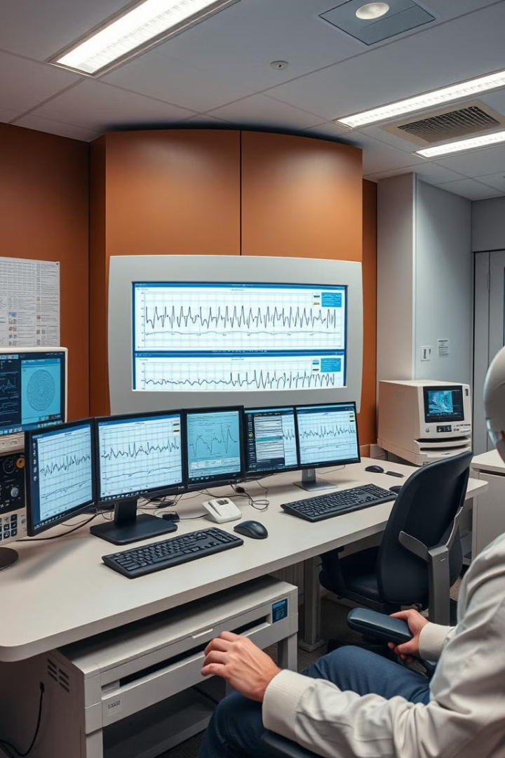
System Requirements
Dataset
MIT-BIH Arrhythmia
MIT-BIH Normal Sinus Rhythm Database
BIDMC Congestive Heart Failure Databases.
Technical
Use Pretained model-AlexNet , SqueezeNet .

Slide 5
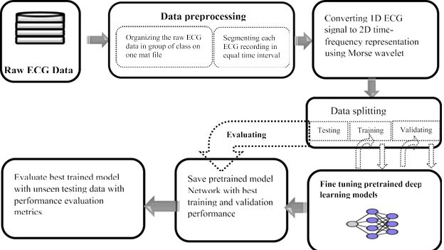
Schemes of overall Methodology:

Slide 6
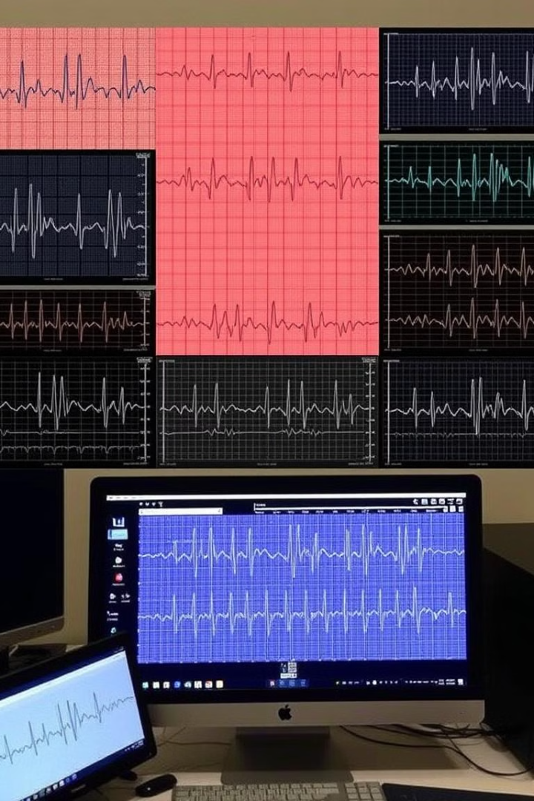
Input Data
1
Raw Signals
ECG signals from MIT-BIH and BIDMC databases.
2
Segmented Data
ECG data with 128 Hz sample rates.
3
Transformed Signals
Morse Wavelet transformed ECG signals converted into 2D images.

Slide 7
Preprocessing
Our data carries total 162 ECG signal recordings of size 65,536 samples each.
For our problem, we preprocess the dataset. Each recording is of 65,536 samples therefore , it is broken into small signals of length 500 samples to increase the size of dataset to make it appropriate to train a CNN.
So for this purpose:
- We take 30 recordings of each type to have equal distribution.
- Each recording is broken into 20 pieces of length of 500 samples.
- Therefore, each category will provide 600(30*20) recordings of size 500 samples and total will be 1800 recordings.

Slide 8
Converting ECG signals into Images using CWT
We will convert all the ECG signals into images using Continuous Wavelet Transform so that they can be fed as input to some CNN for classification.
We take CWT of all the signals and form a CWT Scalogram .
Each scalogram is represented in colormap of type jet of 128 colors.
Scalogram is converted into image and saved in folder corresponding to each class.
Each image is of size 227* 227 in RGB color format which used for the AlexNet.
After conversion, we have total 1800 scalogram images saved in three folders corresponding to each category ARR, CHF and NSR.

Slide 9
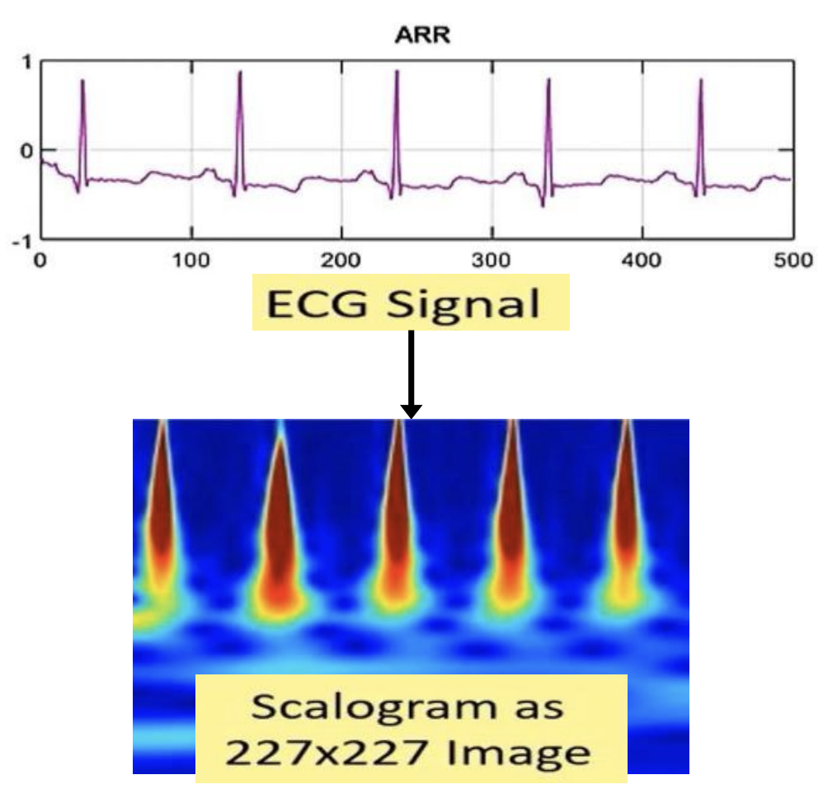
For Continuous Wavelet Transform, we are taking following parameters:
The wavelet we have used is morse wavelet (amor), this wavelet has equal variance in time and frequency.
Morse wavelet are wavelets with one-sided spectra, and a complex valued in time-domain.
These wavelets are a good choice for obtaining a time-frequency analysis using CWT.
12 wavelet band pass filters per octave are used for CWT.
It means we use 12 different band pass filters to convert 1D signals into the wavelet coefficient.

Slide 10
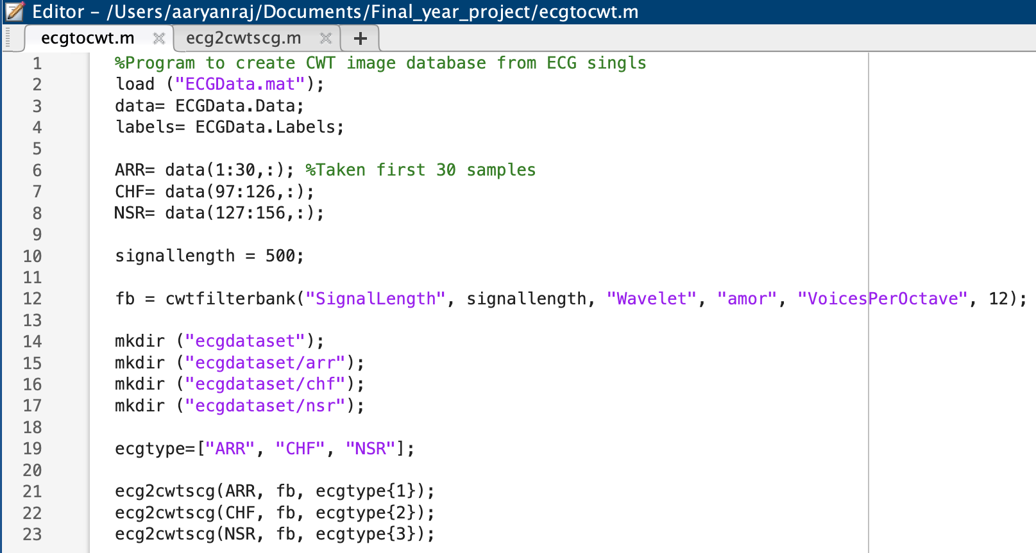
1. ECG to CWT

Slide 11
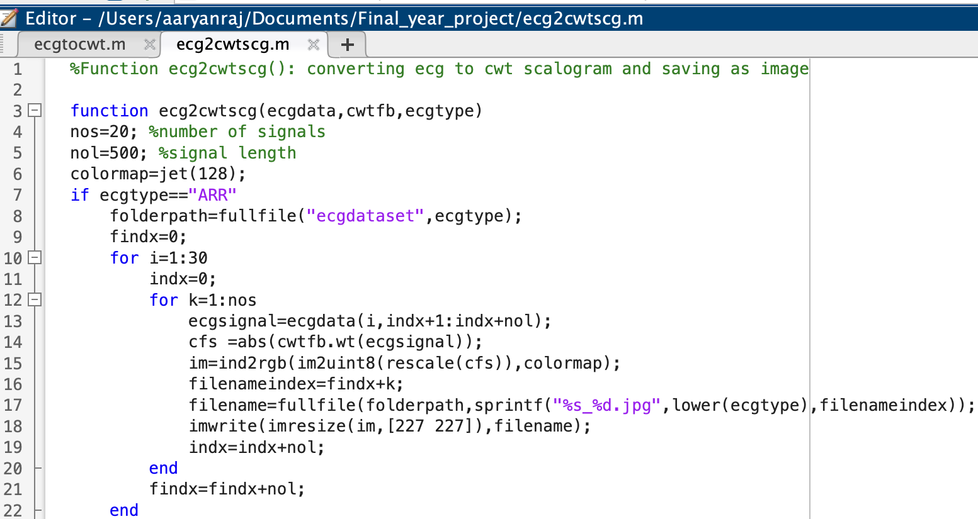
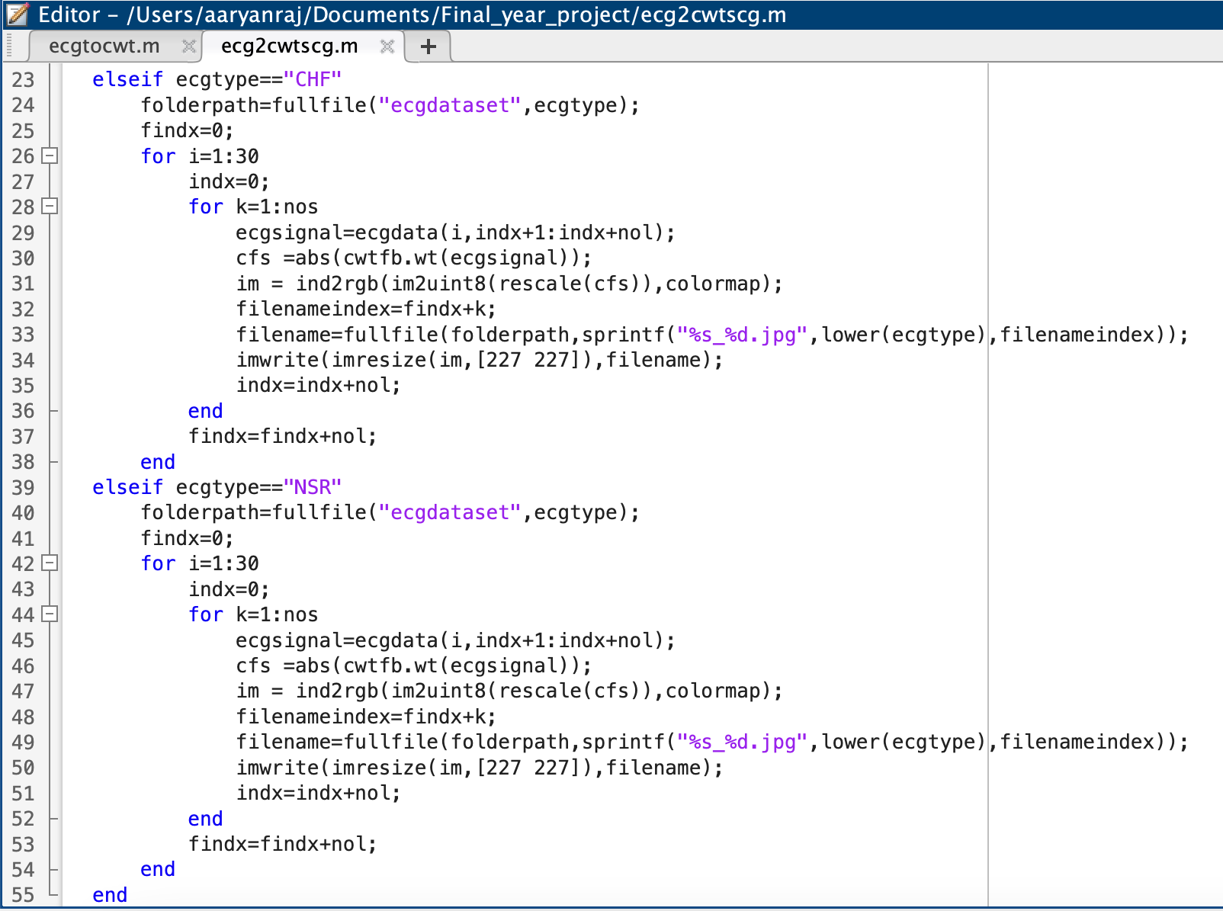
2. ECG to Scalogram :

Slide 12

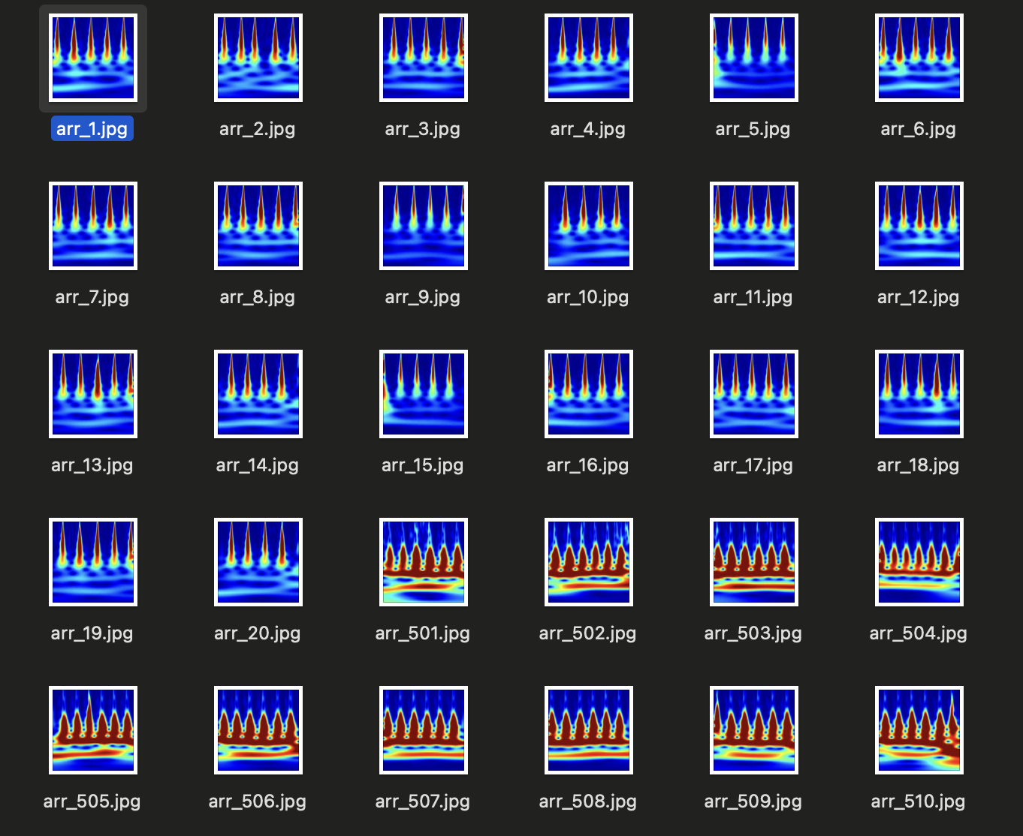
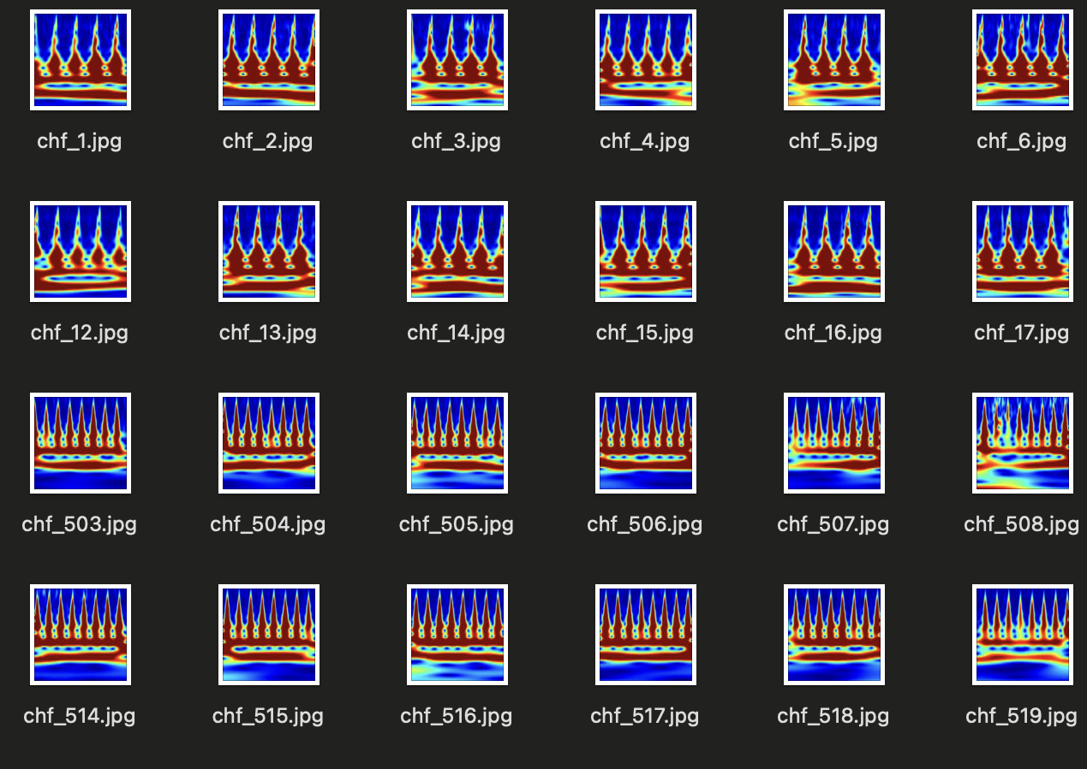
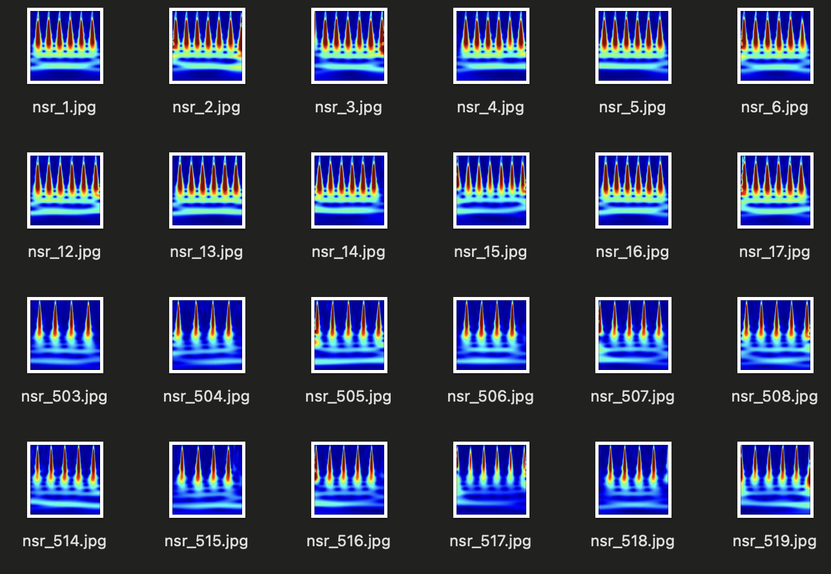
CWT Results
CHF Data Scalograms
ARR Data Scalograms
NSR Data Scalograms

Slide 13
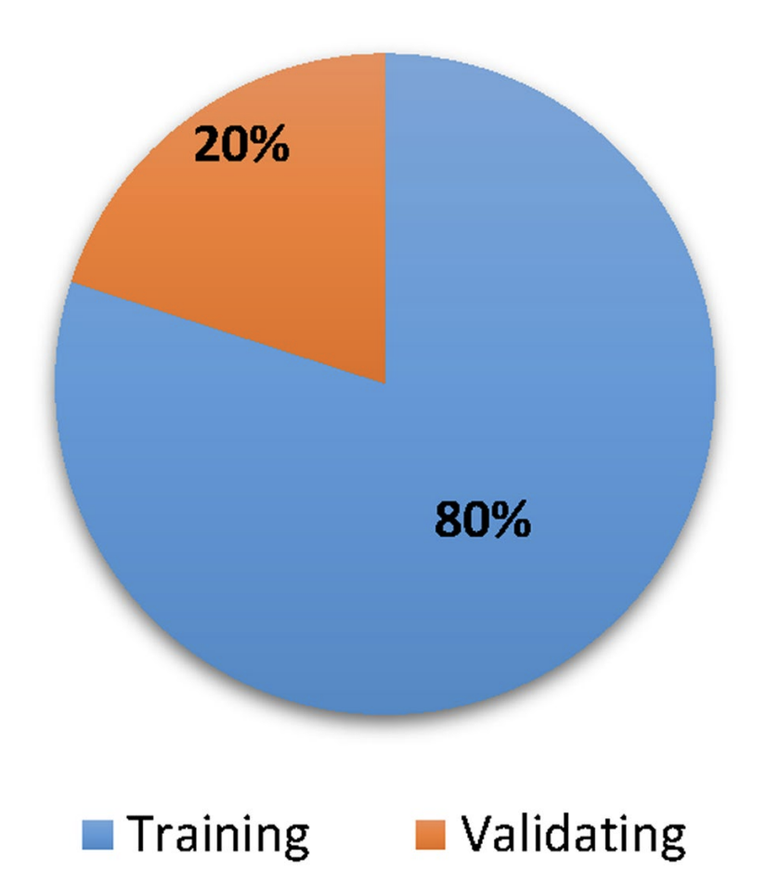
Data Split Scheme:
Total images generated: 18,00 time-frequency images (600 per class).
Training data(80%): 1440 images (480 per class)
Testing Set (20%): 360 images (120 per class)
Internal Validation During Training: From the training set (1440 images):
Training Data: 1152 images (384 per class)
Validation Data: 288 images (96 per class)
Models used: AlexNet, SqueezeNet
Training process: Models were trained until they reached the best performance on the validation data set.

Slide 14
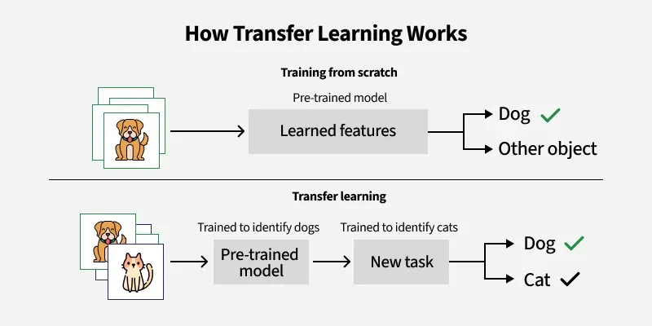
Transfer Learning
Transfer learning is a process that involves fine tuning of a pre-trained model.
After making some changes to the network, we can perform a new task.
This also has the advantage of needing much less data so computation time becomes less.
Transfer Learning is quick and easy rather than training a CNN from scratch which requires millions of input images, lots of training time and high speed efficient hardware.
Pretrained models like SqueezeNet, AlexNet, and GoogLeNet are often used for transfer learning.
In this work, AlexNet and SqueezeNet is chosen because there is no GPU, limited memory, and a need for good accuracy.
https://doi.org/10.1109/TKDE.2009.191

Slide 15
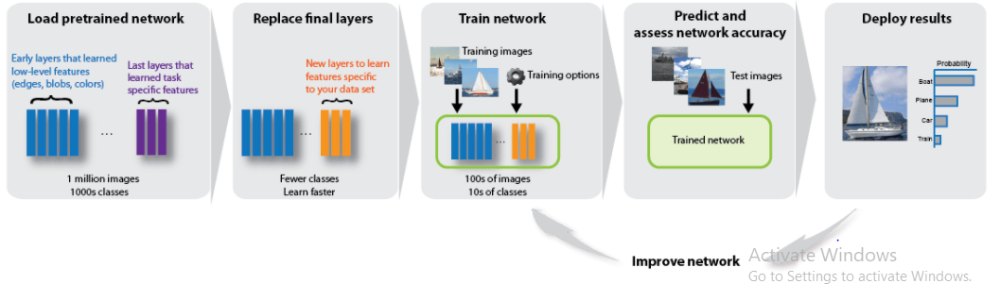
AlexNet
AlexNet is pretrained CNN that has been trained on approx. 1.2 million images from the ImageNet Dataset.
The model has 8 layers and classify images into 1000 different object categories.
Relu is applied after every convolutional and fully connected layer.
The AlexNet has an input image of RGB Image of size of 227x227.
Dropout is applied before the first and the second fully connected layer.
The key feature of AlexNet is training on GPU architecture.
https://arxiv.org/abs/1404.5997

Slide 16
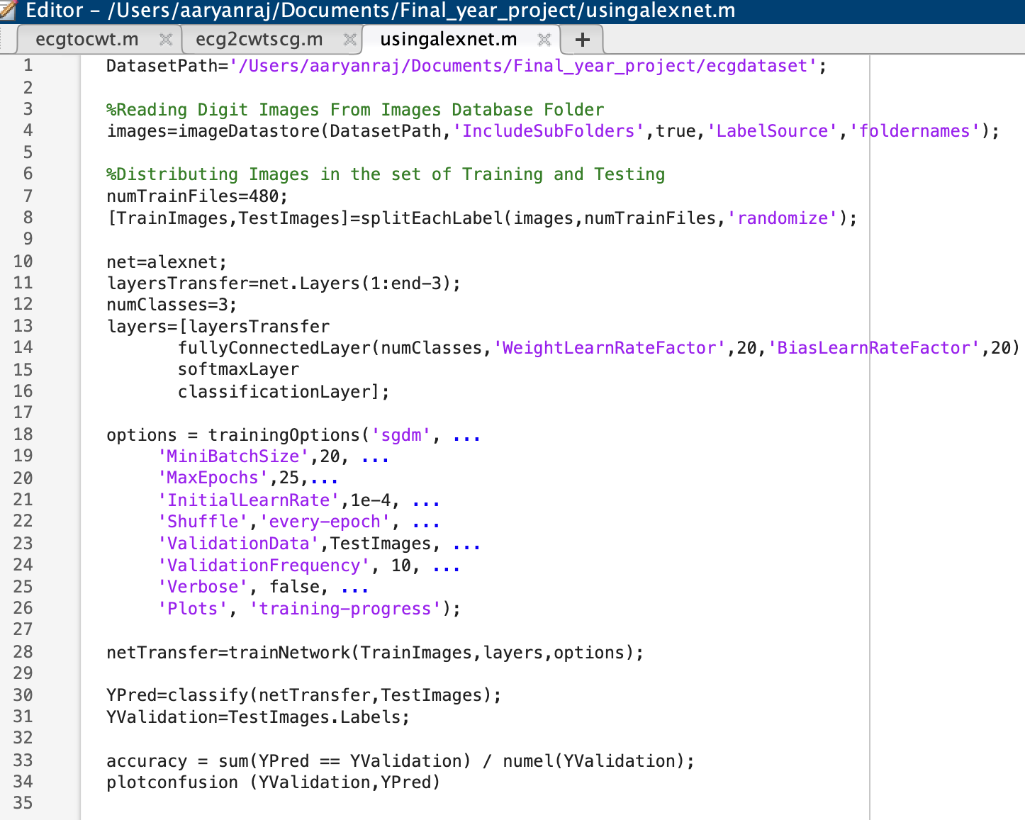
3. Implimentation of AlexNet:

Slide 17
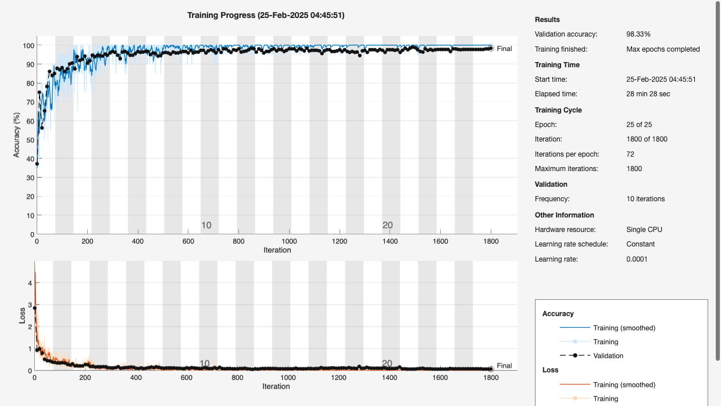
AlexNet Results
Results of the AlexNet transfer learning model can be seen in the below image. AlexNet model tuned to fit our dataset is giving us 98.33% accuracy.
Although this accuracy can be increased by fine tuning the model and also by training the model for a longer time to get a fully trained model with higher accuracy and better overall metrics.

Slide 18
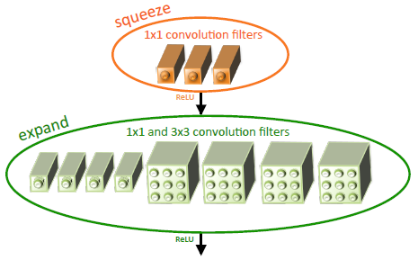
SqueezeNet
It is a deep convolutional neural network (CNN) with compressed architecture design.
The Model contains relatively small amount of parameter.
It tries to achieve AlexNet level accuracy on ImageNet Dataset with 50 times fewer parameters.
It requires less communication across servers during distributed training.
It requires less bandwidth to export a New model from the cloud.
It is more feasible to deploy on the customized hardware with limited memory.
Fire Module : It is the building block used in the SqueezeNet.
https://arxiv.org/abs/1602.07360

Slide 19
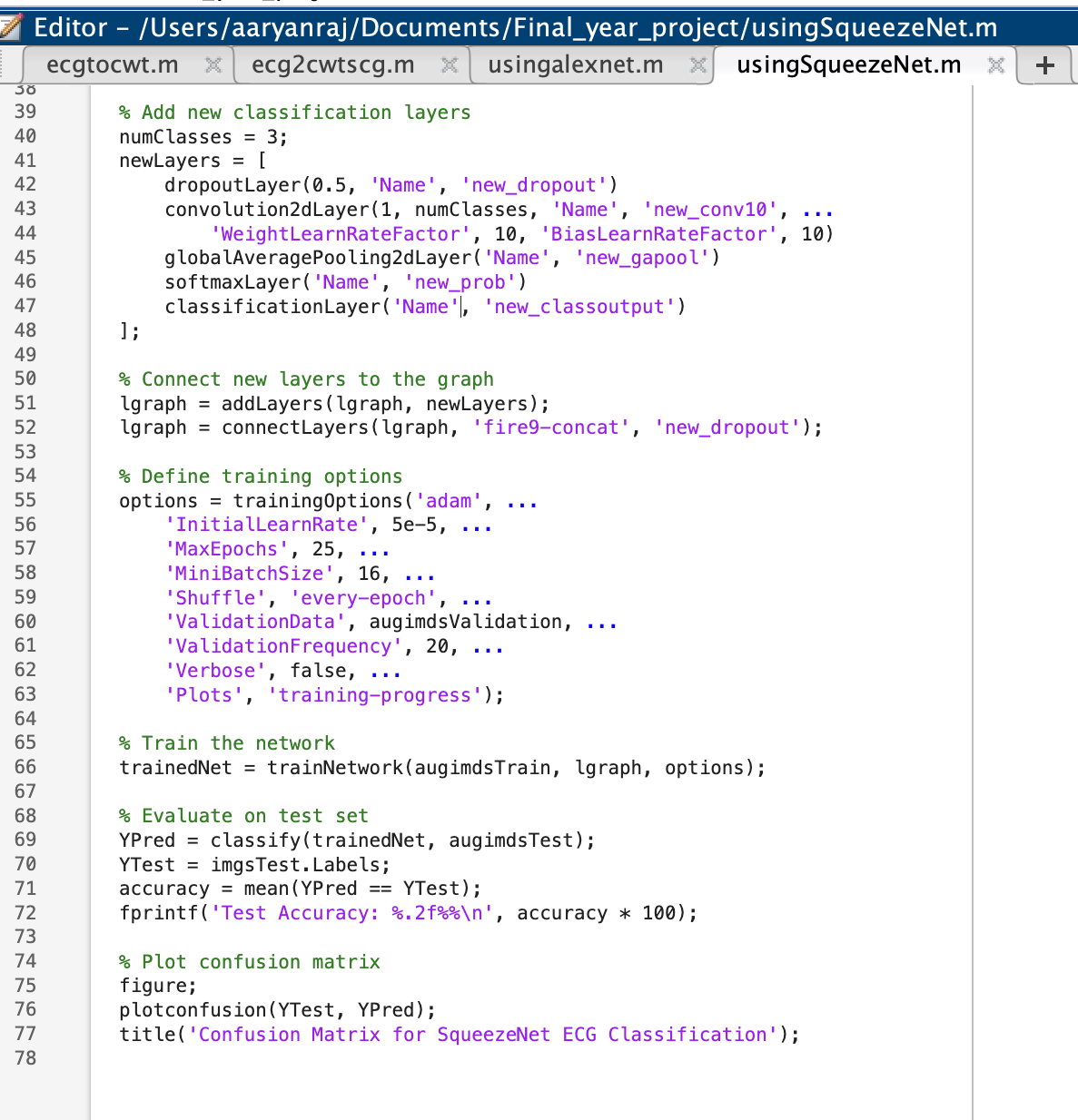
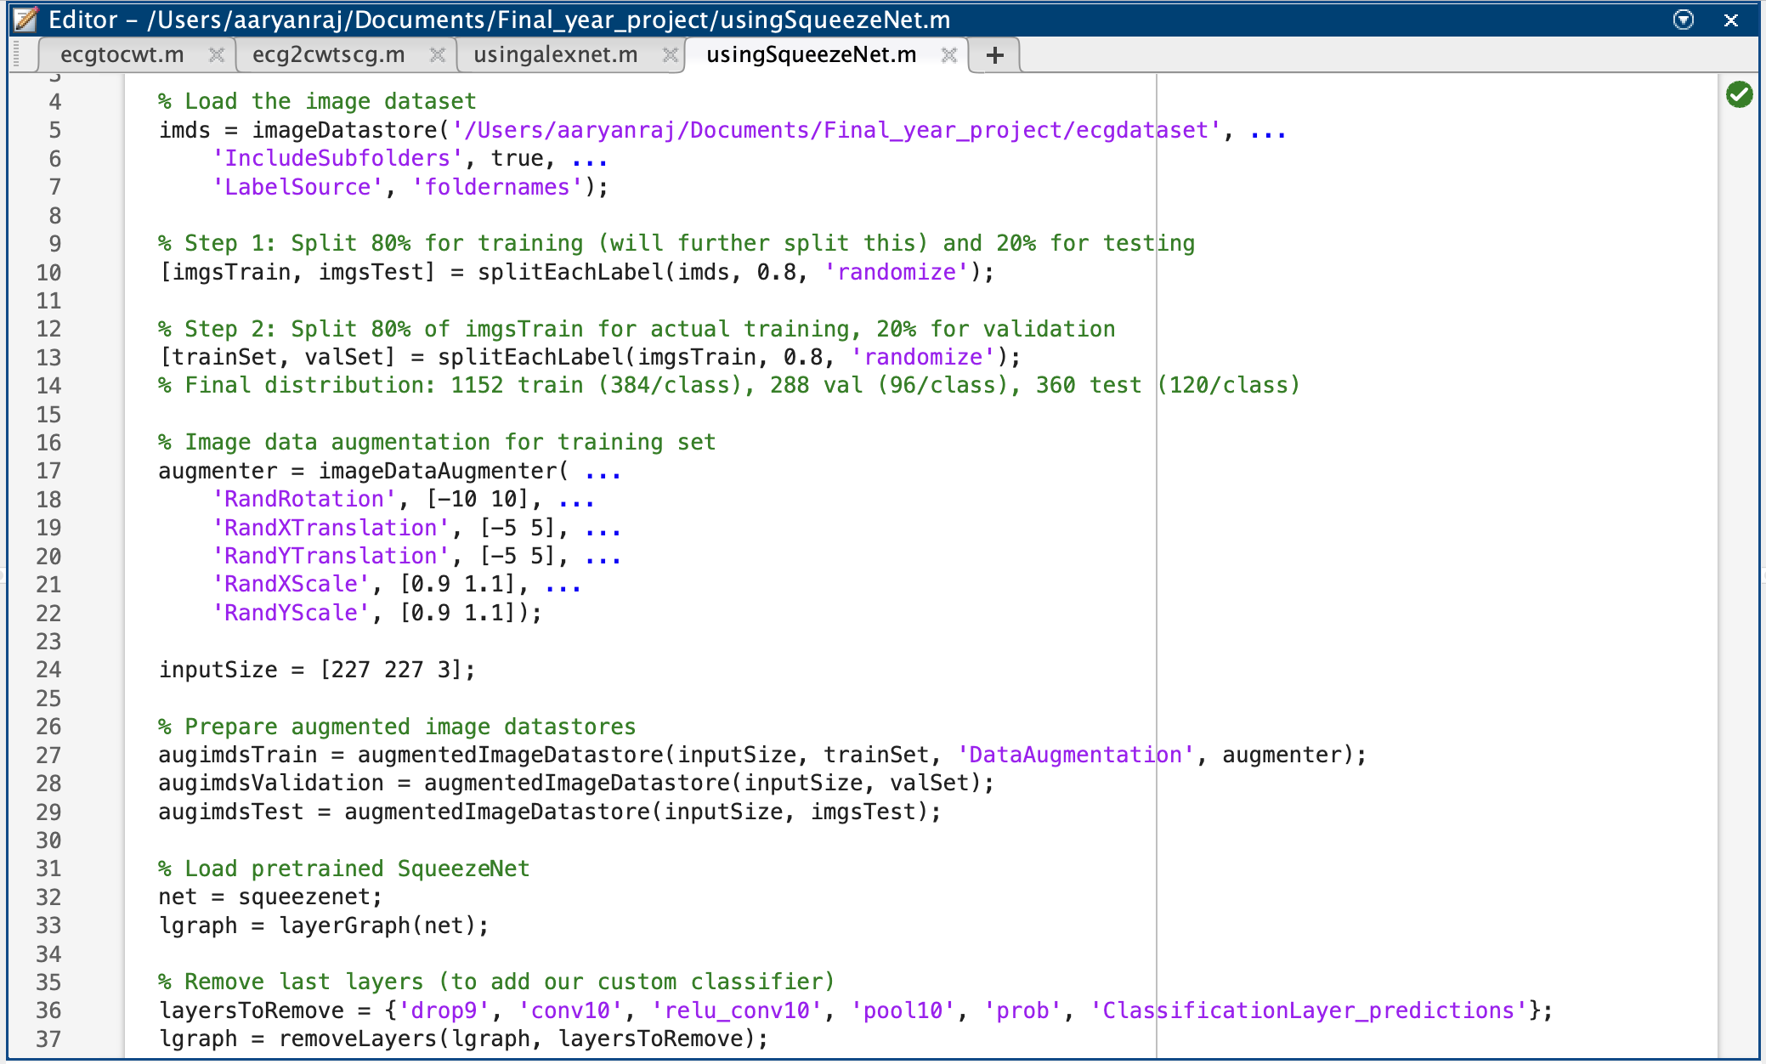
3. Implimentation of SqueezeNet:

Slide 20
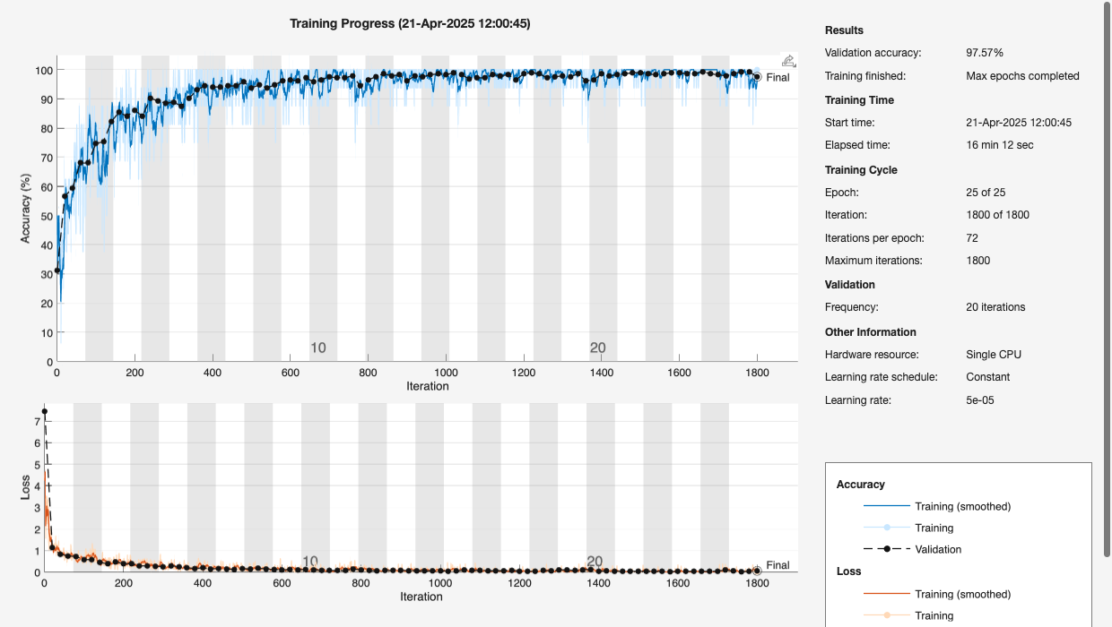
SqueezeNet Results
Results of the SqueezeNet transfer learning model can be seen in the below image. SqueezeNet model tuned to fit our dataset is giving us 97.57% accuracy.
Although this accuracy can be increased by fine tuning the model and also by training the model for a longer time to get a fully trained model with higher accuracy and better overall metrics.

Slide 21
Training Results:
The dataset was randomly split into:
80% Training
20% Testing
Total of 1800 iterations during training
Models Used:
AlexNet
SqueezeNet
Approach:
Transfer Learning with modified final layers for 3-class classification.
Training continued until highest validation performance was achieved.
Model checkpoints saved based on highest validation accuracy.
Validation Accuracies:
🟦 AlexNet: 98.33%
🟧 SqueezeNet: 97.57%
Key Observations:
Despite its lightweight architecture, SqueezeNet performed nearly as well as AlexNet.
Both models effectively learned to distinguish ECG patterns across the three classes.

Slide 22
Testing Results:
Final Model Selected: ✅ AlexNet, based on superior validation performance
Validation Accuracy:
AlexNet: 98.33%
SqueezeNet: 97.57%
Training Observations:
AlexNet showed a smoother, more stable learning curve
SqueezeNet showed minor overfitting, affecting generalization
Testing Dataset:
Total: 360 images
120 per class:
Arrhythmia (ARR)
Congestive Heart Failure (CHF)
Normal Sinus Rhythm (NSR)
Performance Evaluation Metrics:
✅ Accuracy
✅ Precision
✅ Recall
✅ F1 Score
Confusion Matrix:
Used to visualize and assess classification performance across all three classes
Shows true positives, false positives, and false negatives per class

Slide 23
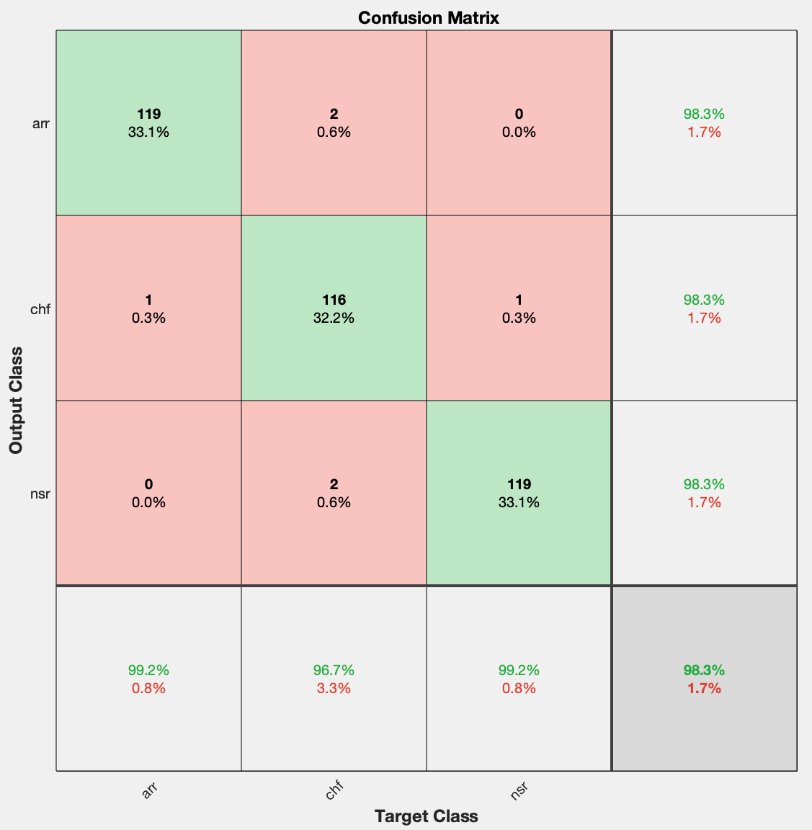
Performance Evaluation Metrics:
Accuracy = (TP + TN) / (TN+TP)
Recall = TP / (TP + FN)
Precision = TP / (TP + FP)
Specificity = TN / (TN + FP)
F1 Score = 2 x ((Precision*Recall) / (Precision + Recall))
Metric | arr | chf | nsr | Overall
Precision | 99.17% | 96.67% | 99.17% | 98.34%
Sensitivity (Recall) | 98.35% | 98.31% | 98.35% | 98.34%
F1 Score | 98.76% | 97.48% | 98.76% | 98.34%
Specificity | 99.58% | 98.35% | 99.58% | 99.17%
Accuracy | - | - | - | 98.33%

Slide 24
Conclusion
We have used a dataset that consists of signals classified into three different classes, namely, arrhythmia, congestive heart failure and normal sinus rhythm. We have converted 1D ECG signal into 2D image.
To do this, we have used continuous wavelet transform and matlab wavelet toolbox. After applying continuous wavelet transform, we got scalograms, which were further processed and converted into images.
The image dataset that we created were used for applying transfer learning methods. We have used two pre-trained networks, AlexNet and SqueezeNet.
We have used AlexNet architecture and made some changes to make it suitable for our project and reduced the output classes to 3 classes.
The second network that we have used is SqueezeNet architecture. We have used this network because this network tries to achieve an accuracy that is compatible with AlexNet accuracy.

Slide 25
This model is very small when compared to an AlexNet network. We have used this model because this model can prove to be beneficial in creating small hardware and wearable devices.
SqueezeNet network has been trained on a smaller dataset than the dataset used for training AlexNet. Thus, we have tried to use this network as well. But due to limited computational power, we were not able achieve the accuracy that we had hoped for.
Thus, we tried to create a series of neural network that would be suitable for our project.

Slide 26
References
Pan, S. J., & Yang, Q. (2010). A survey on transfer learning. IEEE Transactions on Knowledge and Data Engineering, 22(10), 1345-1359.
Al Rahhal MM, Bazi Y, Al Zuair M, Othman E, BenJdira B (2018) Convolutional neural networks for electrocardiogram classification.
Krizhevsky, A., Sutskever, I., & Hinton, G. E. (2012). ImageNet classification with deep convolutional neural networks. In Advances in Neural Information Processing Systems (NIPS), 25.
Baloglu UB, Talo M, Yildirim O, San Tan R, Acharya UR (2019) Classification of myocardial infarction with multi-lead ECG signals and deep CNN.
Mahmud T, Fattah SA, Saquib M (2020) Deeparrnet: An efficient deep cnn architecture for automatic arrhythmia detection and classification from denoised ecg beats.
Daydulo, Y.D., Thamineni, B.L. & Dawud, A.A. Cardiac arrhythmia detection using deep learning approach and time frequency representation of ECG signals.

